Slide 1
Introducing IOTA Decentralized Oracle
Stefano Della Valle SDV Consulting SRLS

Slide 2
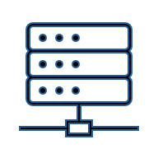
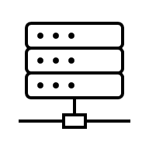
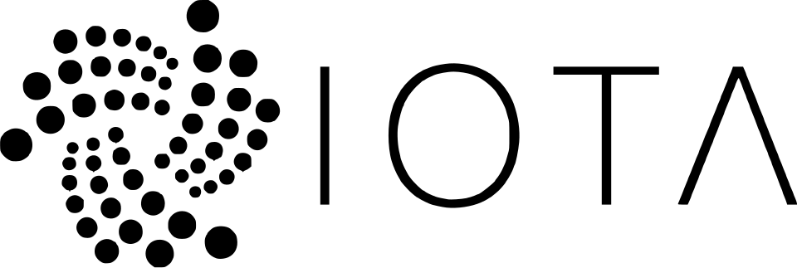
What is a Decentralized Oracle?
A decentralized oracle is a network of independent nodes that securely verifies and delivers real-world data to smart contracts without relying on a single trusted source.
Internet
Oracle
Consensus

Slide 3
Architecture principles
No centralized control system: all tasks and steps are orchestrated by node using two MOVE Packages
No TCP/IP exposure: all requests, information exchanges, results, etc. are transported via IOTA EVENTS
No classroom attack: nodes proves their contribution with a signature and only after reacing a required quote, they reveal the hash of the results
Consensus: the hash is signed with Multi-sign ED25519 signature method, then the Task Result is published
In case the results is expected to be a number, an additiona mediation stage is operated.

Slide 4
Why it is usefull ?
It is useful because it lets smart contracts react to trusted off-chain information - like prices, weather, documents, or external events - without depending on a single centralized provider.
In ObjectID, a decentralized oracle can be used to verify and notarize external data, for example confirming that a GS1 supply-chain event or a certified document matches real-world evidence before anchoring it on-chain.

Slide 5
Task Templates
Task templates in the IOTA Distributed Oracle define how oracle jobs are structured, executed, and validated on-chain.
Each task is based on a registered template, includes an input payload, can be executed only by compatible oracle nodes, and is finalized only when the required consensus is reached.
In practice, the system supports deterministic data-fetch tasks, mediation/consensus tasks, and governance tasks for critical protocol parameters.

Slide 6
Example: Commodity Price Task
Fetches a market price from an external API using an HTTP GET request.
3 nodes query CoinGecko for the Bitcoin/USD price, normalize the JSON response, remove volatile fields such as timestamps, and reach consensus through exact hash matching with a 67% quorum.

Slide 7
Example: Weather Task
Retrieves live weather data from an external API and makes it oracle-verifiable.
3 nodes call Open-Meteo for Rome temperature data, normalize the JSON payload by removing time and environment-dependent fields, and finalize the result only if at least 67% of nodes produce the same normalized hash exact hash matching with a 67% quorum.

Slide 8
Example: Number Mediation
Oracle nodes query an external random-number source, then instead of requiring identical values, the protocol applies a mediation rule that computes a mean value within an allowed variance threshold before finalization.

Slide 9
Under development: Distributed Storage
Retrieves a remote file, verifies that all selected nodes obtain the exact same content, and then stores a shared agreed result on-chain. 3 nodes download a PDF from a URL, preserve metadata such as filename and MIME type, apply exact hash consensus. File are stored in independent IPFS nodes.

Slide 10
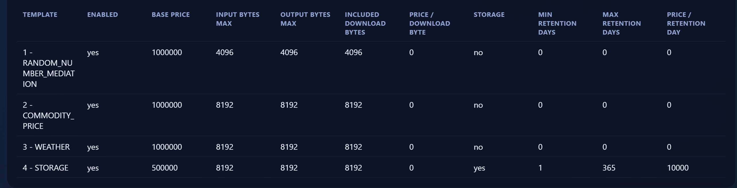
Price model

Slide 11
Governance
The oracle admin has a Controller Cap that grant to propose new Templates.
New templates become enabled only if the majority of the nodes approve the proposal.

Slide 12

Why we need you ?
Node are randomly selected from the list of registered node.
Sign the results with a multi-signature procedure their results.
Gain the reward.
So, in theory, there are few risk of malicious behaviour. But anonymous node can form a cartel!

Slide 13
The solution: only validator can run a Distributed Oracle Node
The idea is simple: to register to the Oracle System State as available, the node need to provide is IOTA Validator Controller CAP. The Move package checks that the validator is actually part of the IOTA validator committee.

Slide 14
Opportunity
Each task has an approved price in IOTA that the client need to cover with sufficient funds.
The payed IOTA are divided by:
90% among the active node that are assigned to the task
10% to the system maintainer

